Slide 1
USER AWARE PERFECTING MECHANISM FOR VIDEO STREAMING
AUTHORS: CHUNG-MING HUANG, TZ-HENG HSU
JOURNAL: SPRINGER
PRESENTED BY : SUMAN NANDI (2K20/SWE/23)

Slide 2
ABSTRACT
The randomly and unpredictable user behaviors during a multimedia presentation may cause the long retrieval latency in the client–server connection.
The data mining technique can provide some priority information such as the support, confidence, and association rules which can be utilized for prefetching continuous media.
The proposed prefetching policy can predict user behaviors and evaluate segments that may be accessed in near future.
The proposed prefetching scheme was implemented and tested on synthetic data and was effective in improving the latency reduction.

Slide 3
INTRODUCTION
The increasing use of multimedia transmission causes overloading of media transmission, which increases multimedia retrieval latency and makes the infrastructure’s backbone be the bottleneck.
To reduce the overloading of media transmission, proxy servers are often deployed in networks to cache frequently accessed documents.
Since a proxy is very close to its clients, a shorter round trip time and higher bandwidth connectivity can be achieved between the proxy and clients.
Despite the success, proxy server have not been used widely and effectively for caching multimedia streams, such as audio and video.

Slide 4
INTRODUCTION (CONT.)
The demand of large storage space and bandwidth make the object-based cache schemes less efficient and unsuitable in caching continuous media.
Another problem of caching continuous media is the randomly and unpredictable user behaviors during a multimedia presentation.
To accommodate the above problems, a prefetching scheme is proposed.
The prefetching scheme is used to save the media data temporally in proxy for future use. When the media data are actually requested, users can retrieve these data from the proxy immediately.
The data mining technique can analyze the past user behaviors to derive and then predict the future user behaviors.

Slide 5
REAL TIME STREAMING PROTOCOL
Real Time Streaming Protocol (RTSP) is a client–server multimedia presentation control protocol.
RTSP is designed for two main purposes:
To address the needs for efficient delivery of streamed multimedia over IP networks.
To work with time-based media, such as streaming audio and video.

Slide 6
RTSP CONTROL MESSEGE FUNCTIONS
The functions of RTSP control messages are as follows:
SETUP: Request the server to allocate resources for a stream and start an RTSP session.
PLAY: Start data transmission for a stream allocated via SETUP.
RECORD: Record data transmission of a stream allocated via SETUP.
PAUSE: Temporarily halt a stream’s data transmission without freeing server resources.
TEARDOWN: Free resources and cease the RTSP session.

Slide 7
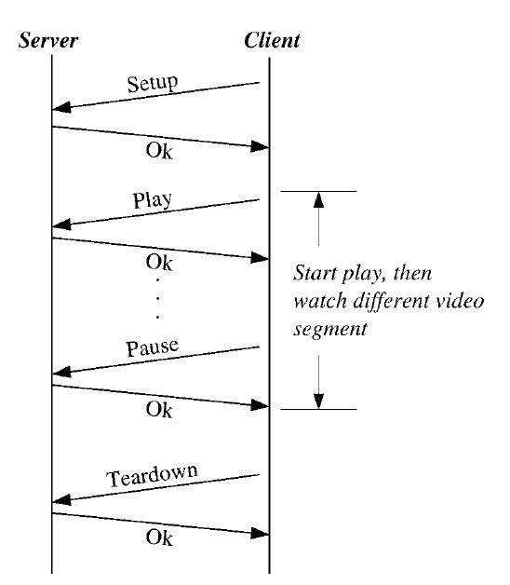
RTSP MESSAGE FLOW FOR A VIDEO STREAM

Slide 8
USER BROWSE PATTERN OF A STREAM
The “Range” field of the request and response header specifies a range of time at which the operation is executed.
Ranges are half-open intervals, a range of a–b starts exactly at time a, but stops just before b.
The “Range” field and relevant RTSP control messages can reveal the user’s behavior.
By finding the relationships between movie clips, the hit rate of caching and prefetching can be increased, and the start-up delay of a movie can be reduced.

Slide 9
USER BROWSE PATTERN OF A STREAM (CONT.)
A user may sometimes randomly browse video clips, and then soon skip to next one unconsciously.
These kinds of user behaviors may cause the data mining result inaccurately. Therefore, in order to make the data mining result more accurately, some functions are needed to prune the unconscious user behaviors.
For this concern, a Playtime Threshold is defined to discard this phenomena. If the user playtime is shorter than the playtime threshold then this user action will be considered as an unconsciously random browse behavior.

Slide 10
USER BROWSE PATTERN OF A STREAM (CONT.)
Our goal is to minimize the startup latency when a user requests functions such as freeze-restart and skip, either forwardly or backwardly.
Therefore, only the start and end points of the movie clips that were browsed by users are taken into consideration.
A simple segmentation scheme is adopted in this approach. Blocks of a media file are grouped into equal-sized segments.
The start and end points of the movie clips can be identified by mapping the start/end values of the relevant RTSP “Range” field into corresponding segments.

Slide 11
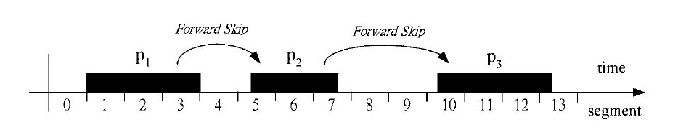
A SAMPLE USER BROWSE HISTORY

Slide 12
USER BROWSE HISTORY
The figure in the previous slide depicts that the user watches three different parts of a movie, in which P1 contains segments {1, 2, 3}, P2 contains segments {5, 6, 7} and P3 contains segments {10, 11, 12, 13}.
Since taking the middle parts of the browsed segments into data mining can’t help to minimize the start-up latency when a user requests VCR-like functions, the middle part of the movie segments that were browsed by users are removed.
After removing the unneeded segments, only the start and end points of the browsed segments, i.e., P1:{1, 3}, P2: {5, 7} and P3: {10, 13}, are taken into data mining. The resulted interesting rules may look like 3 ⇒ 5 and 7 ⇒ 10, which implies users watch segment 3 may watch segment 5, and users watch segment 7 may watch segment 10.

Slide 13
MINING USER BEHAVIOURS
In the following slides, association rule mining scheme will be explained. Association rule mining searches for interesting relationships among items in a given data set.
The goal of mining association rules is to find all the association rules that have a support and a confidence greater than a specified threshold.
Let I = {il, i2, . . . , in} be a set of items. Let D be a set of user transactions, where each transaction T is a set of items such that T ⊆ D.
Support s is in fact a measure of probability, P(X ∪ Y). Confidence c is in fact a measure of conditional probability, P(Y|X).
support(X ⇒ Y) = P(X ∪ Y), confidence(X ⇒ Y) = P(Y|X).

Slide 14
MINING USER BEHAVIOURS
Support indicates the frequencies of the occurring patterns in the rule. Confidence denotes the strength of implication.
The following rule is an example of an association rule:
computer ⇒ financial_management_software [sup = 2%, conf = 60%].
A support of 2% means that 2% of all the transactions under analysis show that computer and financial management software are purchased together. A confidence of 60% means that 60% of the customers who purchased a computer also bought financial management software.

Slide 15
MINING USER BEHAVIOURS
To mine associations among video segments, we treat each user session as a transaction and find frequently occurring patterns among different sessions.
A session consists of a group of continuous client requests and represents a period of user interests for a particular movie.
A media file is divided into multiple segments, in which a segment is the smallest unit for prefetching and caching.
Apriori is a basic algorithm for mining frequent itemsets for association rules. The name of the algorithm is based on the fact that the algorithm uses prior knowledge of frequent itemset properties.

Slide 16
APRIORI ALGORITHM
Apriori employs an iterative approach known as a level-wise search that starts with large 1-itemsets, i.e., the itemsets that contain only 1 item, and then increase the number of items to k to discover large k-itemsets.
In the next slide, a sample data is taken to explain how the video data mining is done using Apriori algorithm.

Slide 17
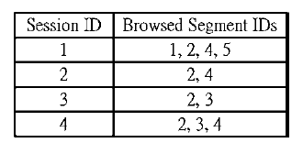
SESSION DATA WITH A SINGLE STREAM

Slide 18
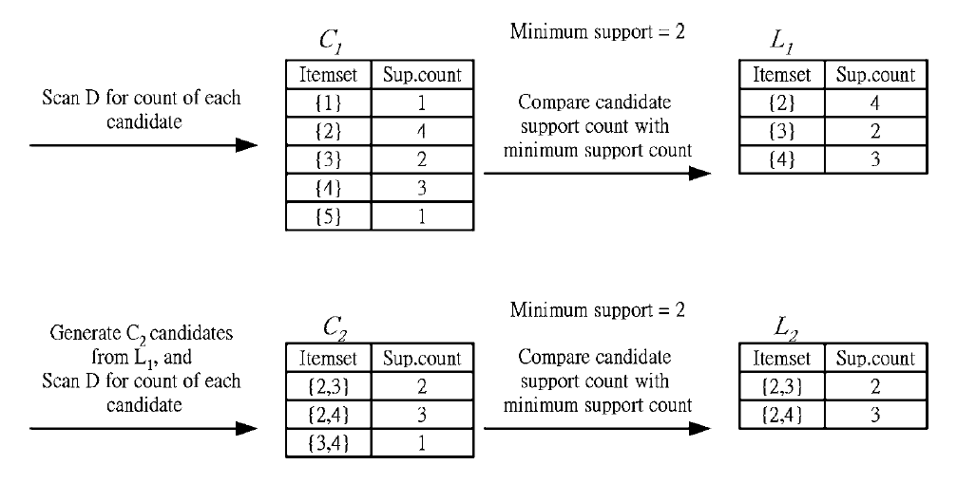
Generation Of Candidate Itemsets And Frequent Itemsets

Slide 19
ASSOCIATION RULE RESULTS
The resulted association rules are as follows:-
item2 ⇒ item3, confidence = P(item2 ∪ item3)/P (item2) = 2/4 = 50%
item2 ⇒ item4, confidence = P(item2 ∪ item4)/P (item2) = 3/4 = 75%
item3 ⇒ item2, confidence = P(item3 ∪ item2)/P (item3) = 2/2 = 100%
item4 ⇒ item2, confidence = P(item4 ∪ item2)/P (item4) = 3/3 = 100%
The association rule mining may potentially consume lot of computing resource. To prevent this problem, the mining algorithm is periodically invoked by the proxy, this can reduce the computing overhead caused by the mining algorithm.

Slide 20
STARTUP DELAY CHARACTERISTICS
The Start-Up Delay Td is defined as the time between the user’s issuing Play (from the pause state) to the start of video display.
Network Delay between client and proxy denoted by RTTcp.
Delay of the connection between proxy and server denoted by RTTps.
A Dynamic part Tc, which denotes the time that is required to fill the client buffer.
The startup delay of the active session which hits the prefetched segment can be expressed as Td = RTTcp + Tc
The start-up delay of the missed segment, i.e., the segment is not prefetched, can be expressed as Td = RTTcp + RTTps + Tc

Slide 21
USER AWARE PRE-FETCHING POLICY
Using the data mining technique, a user-aware prefetching is proposed to reduce the transmission latency of an active stream.
When the active stream is to play an interested segment, proxy initiates a connection to the server and acts as a client. Then, the proxy sends prefetching requests for the next video segments of the active stream that are likely to be needed during the playback.
A Sliding Window Protocol is used to prefetch video segments. The “window” is the amount of data that we can receive from the server without having to wait for client requests.

Slide 22
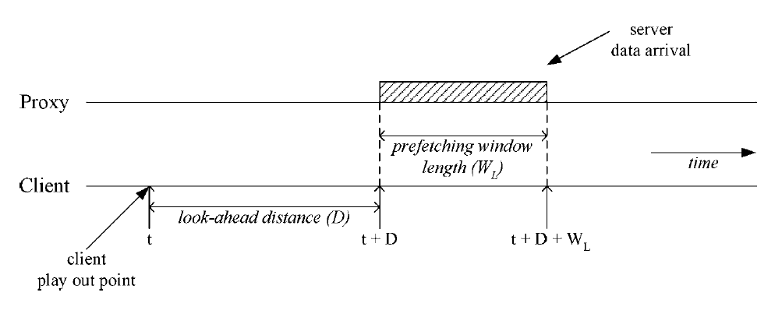
SLIDING WINDOW APPROACH FOR PREFETCHING VIDEO SEGMENTS

Slide 23
USER AWARE PRE-FETCHING MECHANISM
At time t during the client playback, the proxy examines a sliding window [t + D, t + D + WL] to identify required video segments that should be fetched in the near future.
If required segments are not in the cache, then the proxy sends a prefetching request to the server. This prefetching request contains an ordered list of all required segments of the sliding window.
The server transmits all requested segments in the specified order through a congestion controlled connection.
When the proxy is waiting for the requested segments, it evaluates the next interested window and sends another prefetching request to the server. At the same time, the proxy continues the transmission of received data to the client.

Slide 24
CONCLUSION
In this paper, a prefetching policy is proposed that uses the association rules from the data mining result.
The proposed prefetching policy can predict user behaviors and evaluate segments that may be accessed in near future.
Two main conclusions can be derived. Those are:
Prefetching and Caching can have effective latency reduction for continuous media service.
The effectiveness of our prefetching approach depends on the available bandwidth and the confidence and support of the association rules.

